Slide 1
SMCISD Reopening Plan

Slide 2
Where we have been…
SCHOOL STATUS
575,951
Texts
8008
5,478
Google Meets
37,225
Calls
765
Active Google Classrooms
COVID ENGAGED STUDENTS
14,491
Emails
10,096
Assignments
4,896
Student Discussions
650
Videos
C A N V A S E N G A G E M E N T S

Slide 3
What we learned…
01
One Learning Platform
We listened to our families and will be moving to one learning platform PK-12 – Canvas
Devices
02
We will be expanding our 1:1 program to our Pre-K and Elementary students. Pre K – 1 students will receive iPads. 2nd – 5th grade students will receive Chromebooks.
03
Social Emotional Support
SMCISD will offer programs to support our students and staff throughout the 2020-2021 school year, both virtually and in person.
Communication
04
SMCISD is adding a notification center to our district homepage. This notification center will provide constant updates to district families.

Slide 4
Four Guiding Principles
for Student Return
Safety
Ensure the safety and wellness of students and staff including their mental health and social resiliency
Equity
Every SMCISD student deserves a high-quality rigorous academic experience
Flexibility
Provide parents flexibility and choice in instructional delivery models
Resources
We believe that or use of resources to support learning must be effective and efficient

Slide 5
TEA Guidance
Model | Attendance | Instructional Minutes
San Marcos On-Campus Requires all participants to be present. | Teachers take and post attendance on-campus ADA. | Bonham Pre-K (7:40AM – 3:20PM) Elementary (7:40AM – 3:20PM) Middle School (8:15AM – 4:10PM) High School (8:10AM – 4:15PM)
San Marcos Remote Learning Does not require all participants to be virtually present at the same time | Staff will check daily for student “engagement”. If engaged, they are marked Present-Remote-Asynchronous | 3rd through 5th grade – 180 instructional minutes 6th through 12th grade – 240 instructional minutes Instructional minutes are based on each day “engaged” assuming (for secondary) that a student isn’t scheduled to participate in less than a half-day's worth of courses

Slide 6
San Marcos On-Campus Learning
01
In-person instruction is available for students on campuses following a student’s traditional schedule.
02
Students will follow their daily schedule, including all courses selected and/or assigned, as well as extracurricular activities, if applicable.
03
Students will be required to adhere to ever-evolving San Marcos CISD health and safety expectations established for the safety of students and staff within our schools.
04
Grading guidelines will be identical for San Marcos On-campus and San Marcos Remote Learning
05
TEA Guidelines: Students in grades PK-12 will wear face coverings on buses, hallways, common areas, and when social distancing is not feasible, including in classrooms, to the extent it is developmentally appropriate. This applies to both school (indoor and outdoor) and bus settings.

Slide 7
San Marcos Remote Learning
01
Students will engage daily in 100% virtual, online learning with San Marcos CISD certified teachers facilitating students’ learning and coursework.
02
Students will have digital access through Canvas to all their courses, as well as the option to participate in extracurricular activities on campus.
03
Students may have periods of daily, live instruction with certified teachers, as well as periods of self-paced, independent learning.
04
Grading guidelines will be identical for San Marcos On-campus and San Marcos Remote Learning. Weekly feedback will be provided to all students.
05
As is the case for San Marcos On-campus, parents/caregivers are expected to be engaged with their children’s education but are not expected to serve as their children’s primary teacher of the academic curriculum.
06
A designated daily schedule for online instruction will be provided to all San Marcos Remote Learning students that they will be expected to follow. Attendance will be taken for all students every school day

Slide 8
Recommended Academic Calendar
01
First day of instruction moves to September 8. Last day of instruction remains the same – June 3.
02
Converted October 23, January 5, March 5, and April 5 to regular school days
03
All campuses will meet their instruction minutes required by TEA (75,600 minutes)

Slide 9
What are the important dates?
Distribute student survey on preferred learning model. Host virtual meetings.
Learning model reconsideration form goes live
July 20
July 28
Aug. 4
Aug. 17
August 25
Student survey closes
Present Reopening Plan to SMCISD Board
Deadline to reconsider learning model choice
Notes:
Parents will choose remote learning or face-to-face instruction through this survey. This decision will maintain through the first 9-weeks of school.
A form will live on our district website until August 25 that will allow parents to change their form of instruction (remote learning to face-to-face or vice versa)

Slide 10
What are the important dates?
Phase 1
Phase 3
Staff reports to work with safety precautions in place
Learning model choices go into effect.
July 31
Mid - August
Sept. 8
Oct. 5
*Nov. 2
*Requesting the Board of Trustees provide the Superintendent with the authority to extend remote learning by up to 4 additional weeks ending Oct. 30, pending
COVID-19 cases
Due date for staff accommodation requests to HR for review
Phase 2
First Day of School (San Marcos Remote Learning for all students)
Notes:
On 7/7/2020 TEA released the Comprehensive Public Health Guidelines for reopening schools

Slide 11
1
PHASE 1
STAFF RETURNS
PHASE 1
Aug. 14
San Marcos CISD staff members begin to return mid- August (HR will send out reminder)
Teachers report – Aug.14
Professional Development begins Aug. 17
Social distancing will ensue and masks will be provided
Curriculum professional development
Lesson plan designs for remote learning
Digital tools professional development
Remote learning best practices
Canvas
Adaptive software
Notes:
SMCISD will plan for and implement professional development with specific supports for asynchronous instruction
Provide introductory and ongoing content-focused, job-embedded training linked to chosen asynchronous curricular resources
Instructional models
Assessment options
Vertical alignment
Alignment across learning environments and subjects
Building relationships in a remote environment
Meeting the needs of diverse learners remotely and in-building
Technology tools

Slide 12
2
PHASE 2
INSTRUCTION BEGINS
PHASE 2
Sept. 8
Remote instruction begins on Sept. 8 for ALL students
4 weeks of remote instruction*
Teachers teach from their classrooms using web conferencing technology
Every student will have a computing device
Hotspots will be provided with increased capacity
Simplified digital classroom
*Subject to an extension
Notes:
Remote instruction has been streamlined so that there is now only ONE online classroom experience. All student PreK-12 will be using Canvas
Increase rigor of and alignment between remote and bell-to-bell instruction
Dreambox, Lexia, IXL

Slide 13
PHASE 3
Learning Choice Model
Students begin instructional model that aligned to the decision they made on the choice survey
Families that chose Remote Learning for their preferred method of learning, their student will continue with the SMCISD’s Remote Learning
For families that chose SMCISD’s On-campus as their preferred method of learning, Oct. 5 will be the first day of on-campus (in-person) instruction. This day is subject to change. Why?
3
PHASE 3
Oct. 5

Slide 14
Summary
First day of On-Campus is subject to change
TEA guidelines allow districts to offer strictly remote for four weeks. As of today, our first day of On-campus instruction is scheduled for Oct. 5
Tonight, we are requesting the Board of Trustees provide the Superintendent with the authority to extend Remote Learning for up to four additional weeks – per TEA guidelines. If our county does not see a decline in COVID-19 cases, the Superintendent can extend Remote Learning through Oct. 30.
A reconsideration window will open in mid-October if parents choose to change their method of learning for second 9-weeks.
Summary

Slide 15
Teaching & Learning
Social Emotional Learning
Special Programs
05
06
Provide individualized services/supports to meet the needs of students
Committed to staff and student mental health and social resiliency.
Digital Tools
Content Delivery
Adaptive programs will be utilized to build knowledge, skills and fill academic gaps
03
04
Consistent delivery of content from PreK through 12th grade.
Professional Development
Student Engagement
Rigorous remote and face-to-face PD throughout the year
01
02
Data-driven instruction – equivalent content as face-to-face
Instruction will address the same Texas Essential Knowledge and Skills (TEKS) across both remote and in-building instruction.
TEKS from the final quarter of 2019-20 will be incorporated into the first semester of 2020-2021
TEKS Resource System has embedded TEKS aligned scope and sequence to address learning loss
Notes:
These are the considerations for the plan

Slide 16
Special Programs & SEL
Dual Language & Bilingual
Special Education
Translate and provide content language supports on learning platforms to help facilitate use by students and families
Increase fidelity of online program use to provide support/acceleration.
All Special Education services and accommodations/modifications will be offered and provided both physically and remotely
Social Emotional Learning
Career & Technical Education
Deliver responsive SEL supports, including mental health check-ins, planning & goal setting, opportunities for self-reflection, and social interactions.
Family-appropriate social and emotional learning (SEL) content to be used during physical and remote learning
Students will access industry based certification programs and virtual learning platforms remotely.
CTE teachers will innovate instruction instruction to students and utilize innovative techniques that will allow students to see the demonstration of hands-on skills

Slide 17
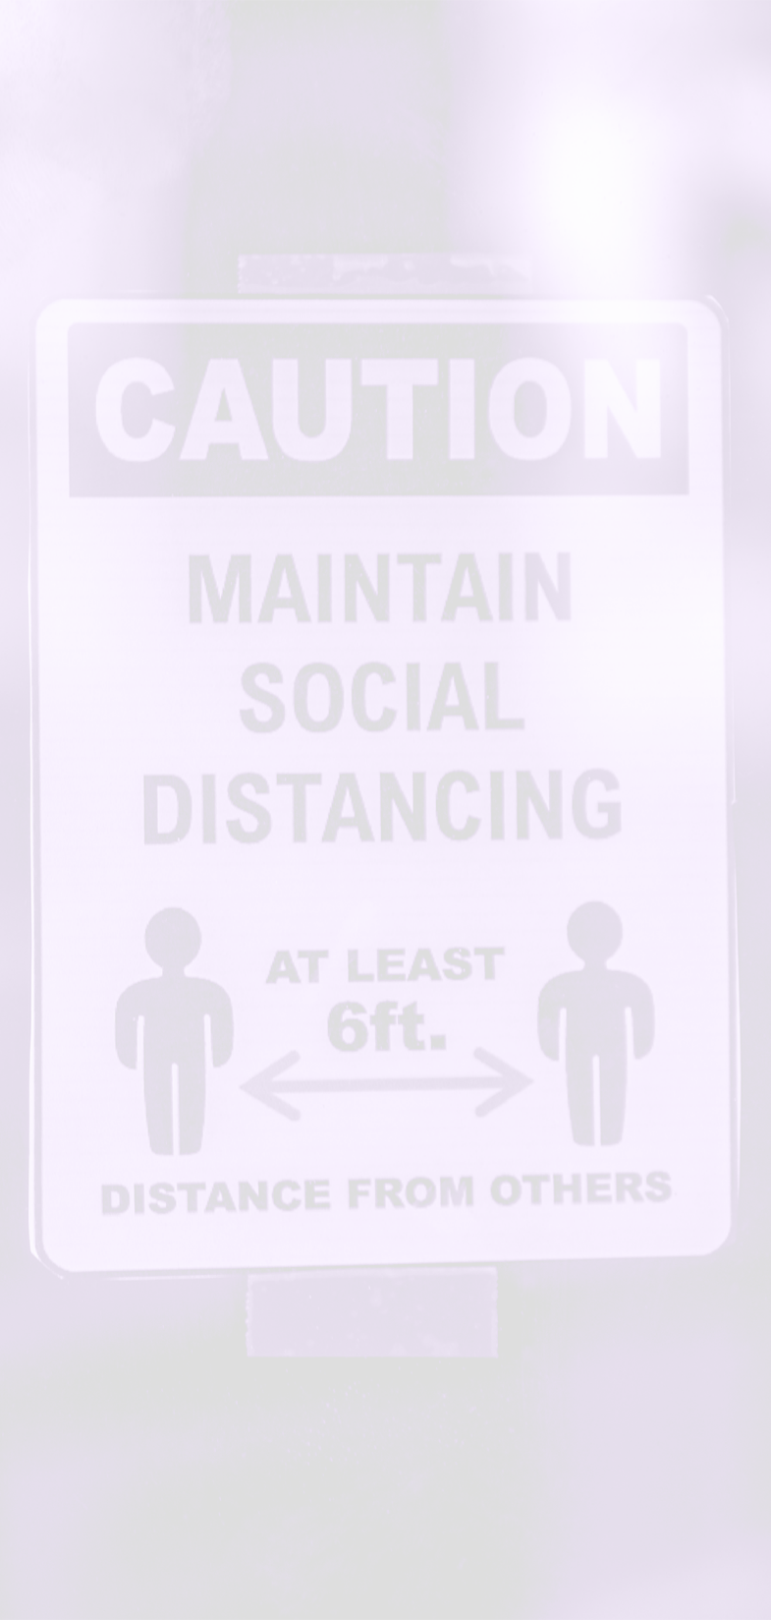
Dividers will be placed in designated areas where proper social distancing is difficult.
Hand sanitation stations will be available at designated entrances and other areas throughout the building
Health & Safety
Masks/Face-coverings are required when physically present.
The district will create universal signage for all facilities
All classrooms will be provided with wipes, cleaner, and hand sanitizer for students to clean their learning surfaces.
Proper cleaning and disinfecting of school workspaces, and high-traffic areas will be conducted routinely throughout the day.

Slide 18
Transportation
01
Bus drivers and attendants will wear face coverings in the presence of students.
Windows will be lowered to allow for appropriate ventilation (weather permitting). Buses will be disinfected on a daily basis. Family members will be seated together, and seating charts will be used to limit possible exposure.
02
TEA Guidelines: All students will wear face coverings on buses to the extent it is developmentally appropriate. Face coverings will be available on school buses for students who arrive without them, although students are expected to bring their own face covering. Hand sanitizer will be provided as students enter and exit the bus.
03

Slide 19
Meals
When/If reporting to the cafeteria for lunch, students will be released on a staggered schedule.
All child nutrition staff will use PPE while performing job responsibilities and will be trained to practice health and hygiene regulations.
Cleaning of students’ spaces will be needed immediately before mealtime as well as directly after meals are finished.
Students will eat meals in all available areas to maximize social distancing. These areas can include classrooms, lunchrooms, and other open areas.
Food delivery services will not be allowed for the first nine weeks. We will reassess the conditions at that time. Campuses will develop procedures for families to drop off lunch to a student if needed.

Slide 20
Human Resources
From the inception of the COVID pandemic, HR has put a process in place to track, monitor, and address COVID-related employee issues
In the case of an individual who was diagnosed with the virus, the individual may return to campus/facility upon submissions of appropriate medical documentation to HR
Employees will self-screen for COVID-19 symptoms before coming onto a San Marcos CISD campus/facility each day.
Employees will practice approved environment cleaning/disinfection, hand hygiene, and respiratory etiquette.

Slide 21
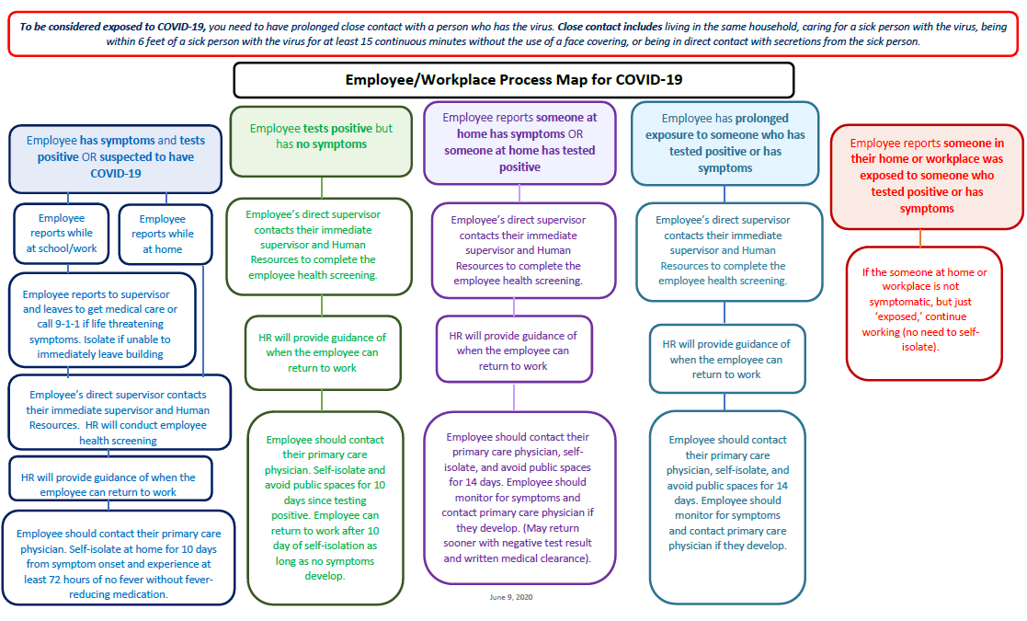

Slide 22
Parent Training and Resources
Resources
Resources are necessary to support students and parents in managing time, space and materials remotely and face-to-face.
Training Tools
C
Read/Write Tool
Clever
Canvas
Digital Citizenship
Parents will learn how their child(ren) create and access content with literacy support features.
Familiarize parents with our district single sign-on portal to access district digital tools
Information campaign to teach parents about our digital learning platform. Make efforts to pre-configure parent portions in their preferred language
Introduce parents/families to digital citizenship and tailor our efforts to meet their needs

Slide 23
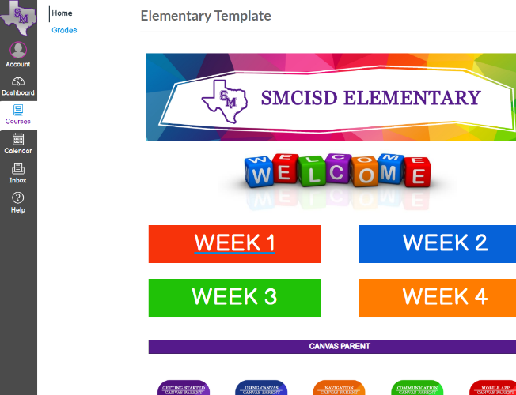
Content Delivery
PreK – 12th Grade
Consistency of Learning
Provides unlimited access to eLearning materials
Easily tracks learner progress and performance
Personalization of learning
Notes:
Rigorous, consistency for face-to-face or remote instruction
instructional alignment
Teacher feedback

